Slide 1
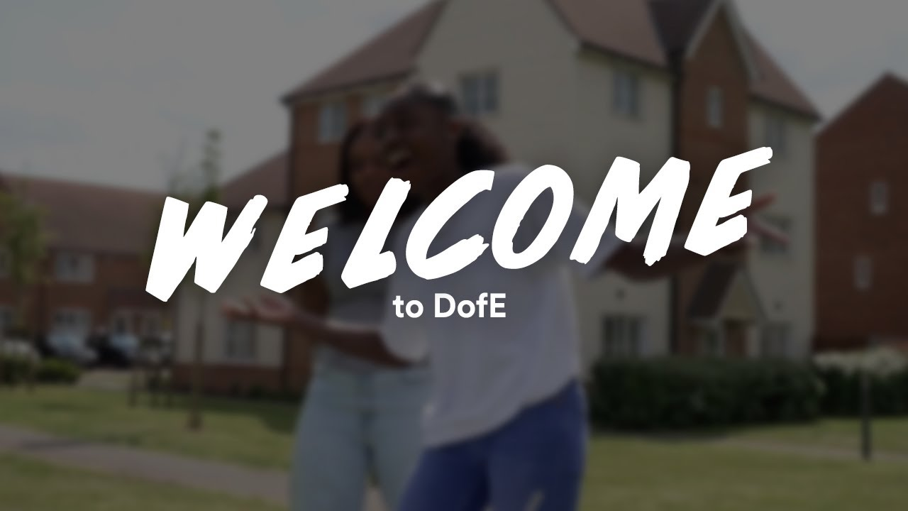

Slide 2


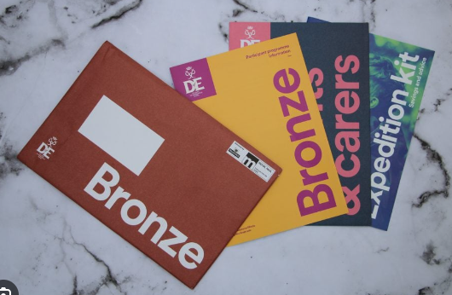
Welcome to the Duke of Edinburgh parent and student support hub at St Paul’s Academy. On this page you will find useful links connecting you to relevant sites and articles supporting your child’s journey through the award.
I would like to take this opportunity to extend my congratulations to all of the students who have now embarked on the Bronze Award and wish you the best in luck to the completion of it. I would also like to extend support to any parents who would like guidance on the award. Please do not hesitate to contact me on my details below.
Kindest regard,
Mr. Davis (gordon.davis@stpauls.greenwich.sch.uk)

Slide 3

Be Who YOU Want to Be!
Please embed this into the website.
https://www.youtube.com/watch?v=yN7wTcxK408&ab_channel=theDofEUK
Duke of Edinburgh provides a platform for the young people of St Paul’s the platform to challenge themselves at St Paul’s and to develop leadership, stewardship and many other skills that would benefit them in as they move on to Sixth Form providers.
Doing your DofE can be particularly beneficial for you as young people – in this part of the website we wanted to introduce you to the course and what it contains but provide stories from young people that have been there before. These students can show how it has made a measurable different to their lives and the confidence in their own skills to go to new environments and thrive.
The video gives a snapshot of the opportunities that you have available at St Paul’s Academy. Participating in the Bronze or Silver Awards give you the chance to a chance to grow!

